Slide 1

Crash Course on Bayesian Modeling
From ZERO to BAYES
Bayesian Data Analysis – A Primer Workshop 2021 Marco D’Alessandro (PhD) ISTC CNR Italy

Slide 2
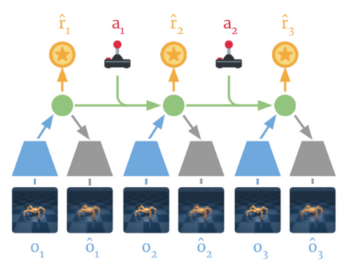
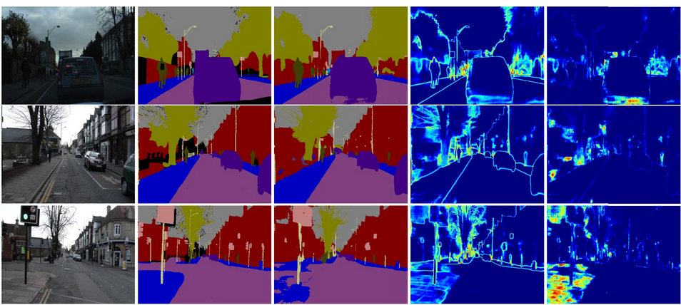
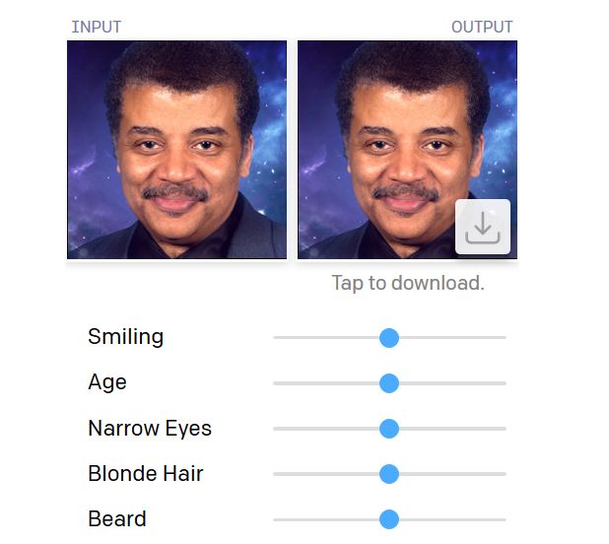
Reinforcement learning, e.g., DeepMind’s dreamer:
https://github.com/google-research/dreamer
Deep computer vision, e.g., semantic segmentation:
https://alexgkendall.com/computer_vision/bayesian_deep_learning_for_safe_ai/
Deep generative modeling, e.g., image generation:
https://openai.com/blog/glow/
Bayesian Data Analysis – A Primer Workshop 2021 Marco D’Alessandro (PhD) ISTC CNR Italy

Slide 3
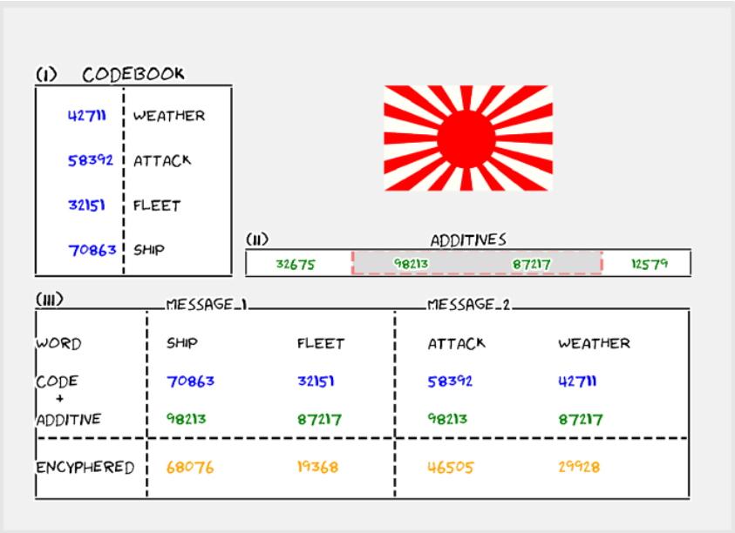
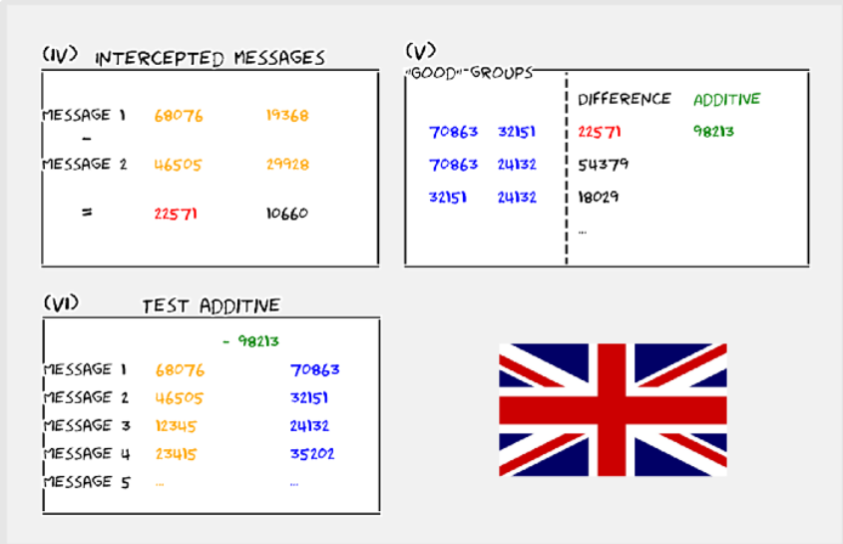
Cracking military ciphers in WWII, e.g., the Japanese Naval cipher (JN 25):
Source: https://towardsdatascience.com/how-bayes-theorem-helped-win-the-second-world-war-7f3be5f4676c
Bayesian Data Analysis – A Primer Workshop 2021 Marco D’Alessandro (PhD) ISTC CNR Italy

Slide 4
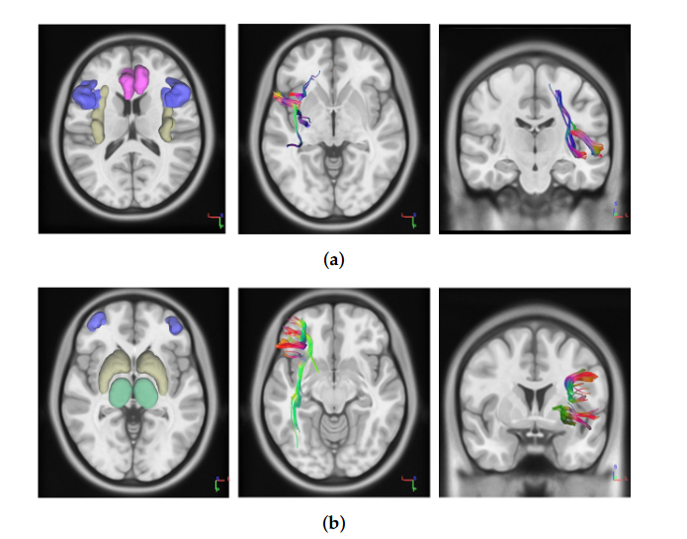

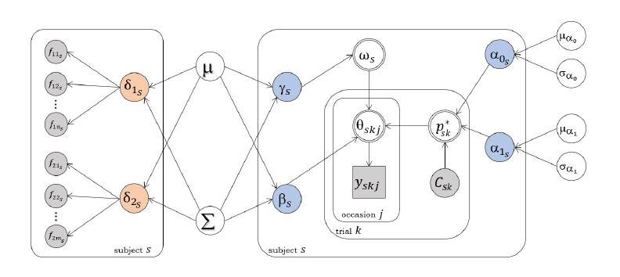
Joint models of neural and behavioral data :
Diffusion Tensor Imaging (DTI) data + Balloon Analogue Risk Task (BART) data
Bayesian Data Analysis – A Primer Workshop 2021 Marco D’Alessandro (PhD) ISTC CNR Italy

Slide 5
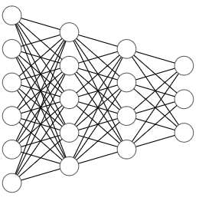
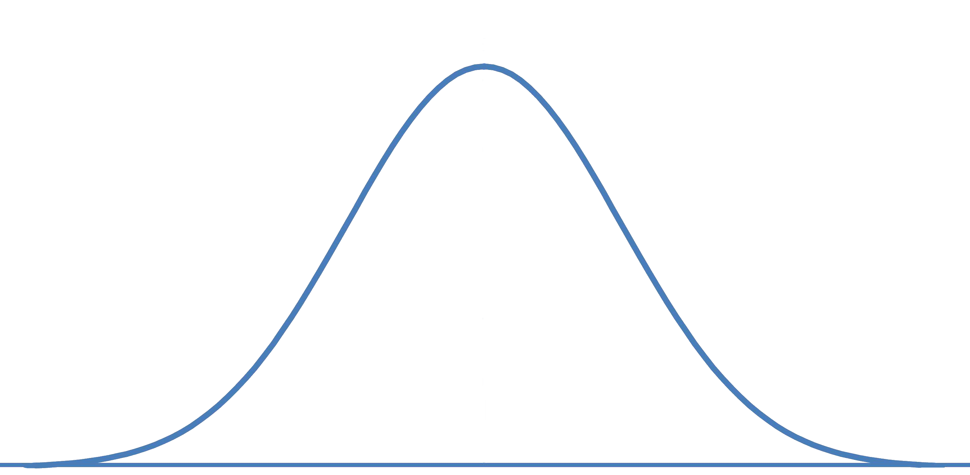


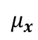

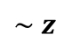


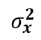
Variational autoencoders (VAE, e.g., Kingma et al., 2013):
Architecture used for various types of unstructured data, e.g., text, images, videos, motion capture data…
Structured latent space
$$x$$
$$\tilde{x }$$
$$μ_{x}$$
$$\sim z$$
$$σ_{x}^{2}$$
$$p(z|x)$$
Encoder
Decoder
Bayesian Data Analysis – A Primer Workshop 2021 Marco D’Alessandro (PhD) ISTC CNR Italy

Slide 6
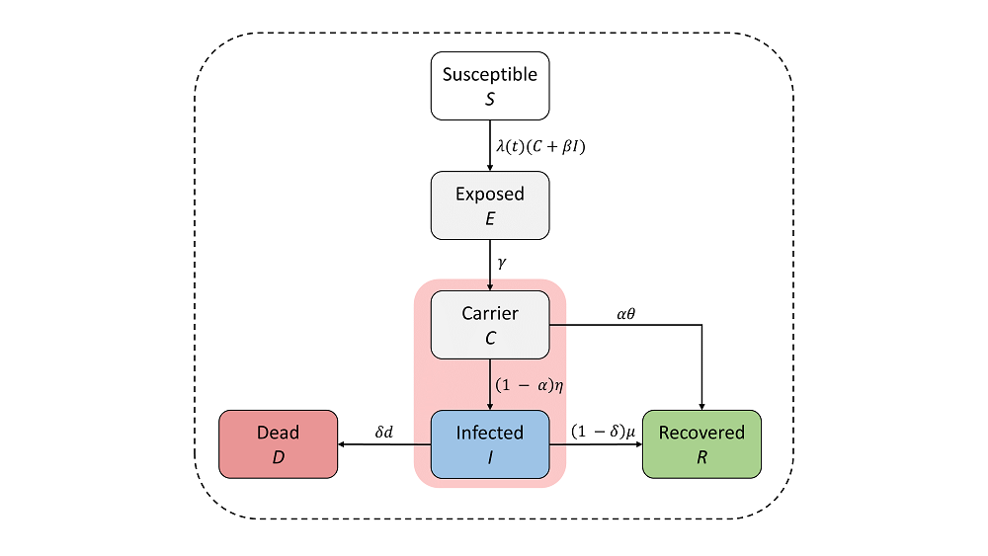
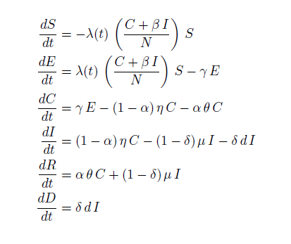
An ODE epidemiological model of control measures and asymptomatic undetected individuals:
Bayesian Data Analysis – A Primer Workshop 2021 Marco D’Alessandro (PhD) ISTC CNR Italy

Slide 7
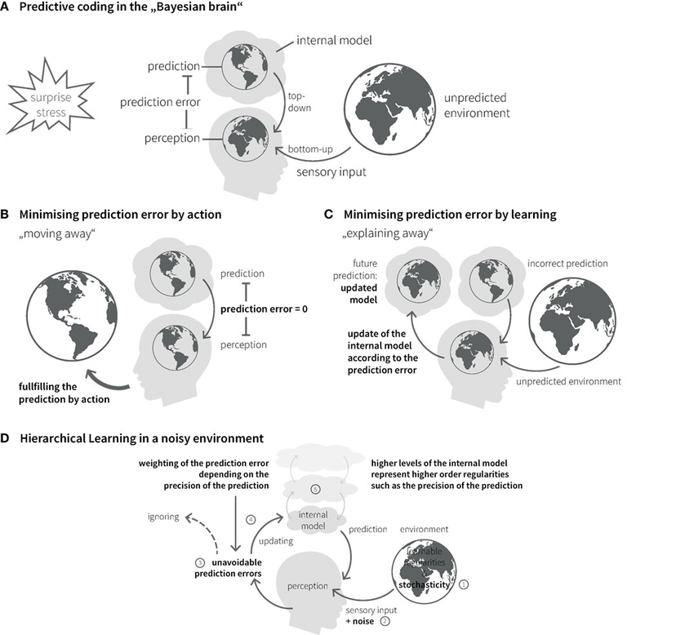
Bayesian Brain Hypothesis
Bayesian Data Analysis – A Primer Workshop 2021 Marco D’Alessandro (PhD) ISTC CNR Italy

Slide 8
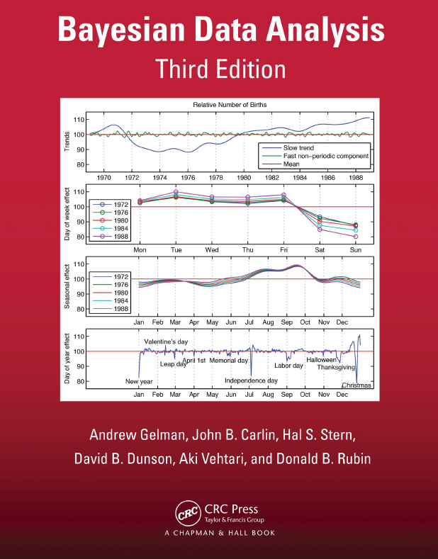
Here, we deal with Bayesian Data Analysis
Bayesian Data Analysis – A Primer Workshop 2021 Marco D’Alessandro (PhD) ISTC CNR Italy

Slide 9
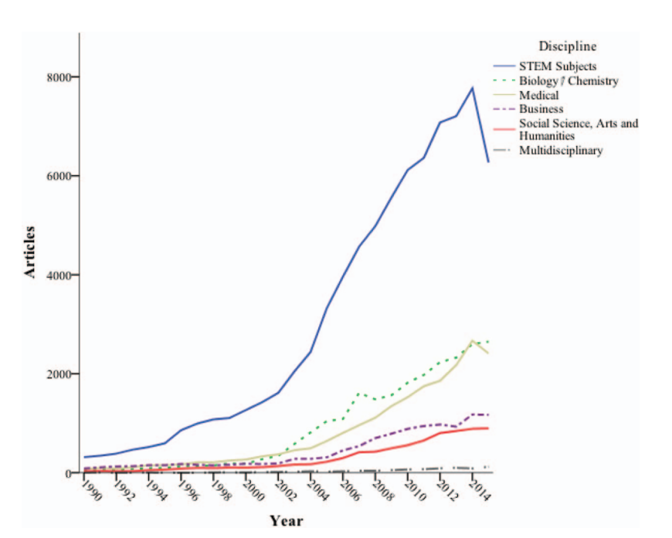
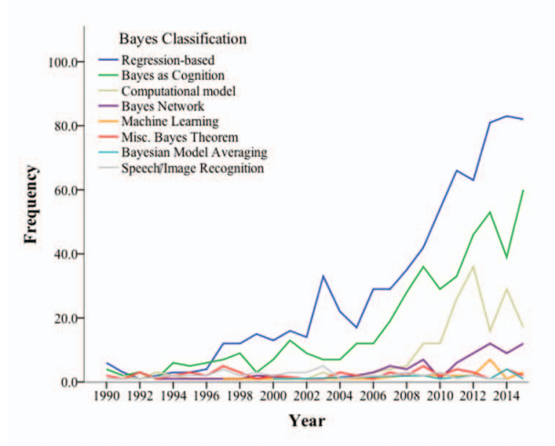
Papers using Bayesian methods
Methodological paper mentioning Bayesian modeling
van de Schoot et al., 2017
Bayesian Data Analysis – A Primer Workshop 2021 Marco D’Alessandro (PhD) ISTC CNR Italy

Slide 10
FIRST:
Bayesian Modeling is nothing more then pure applied probability theory
Bayesian Data Analysis – A Primer Workshop 2021 Marco D’Alessandro (PhD) ISTC CNR Italy

Slide 11
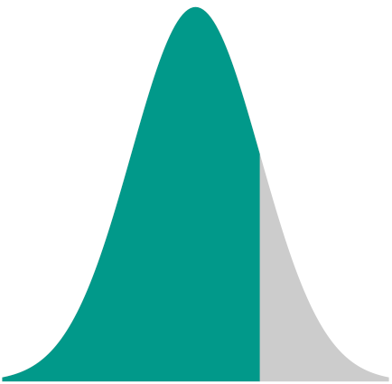

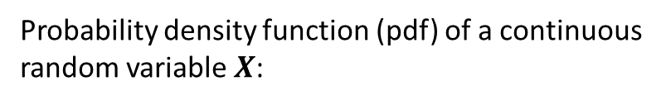
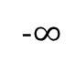
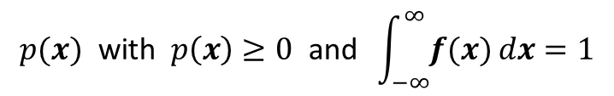
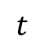
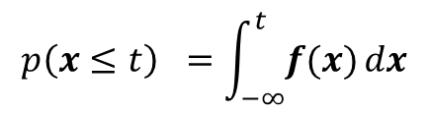
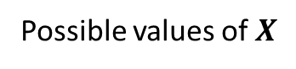
Probability density function (pdf) of a continuous random variable $X$:
Some pdf (e.g. Gaussian)
$$p(x) \text{with} p\left(x\right)≥0 \text{and} \int_{−∞}^{∞}{f(x)}dx=1$$
Gaussian pdf
Possible values of $X$
Area (integral)
-$∞$
$$t$$
$$∞$$
$$p\left(x≤t\right) =\int_{−∞}^{t}{f(x)}dx$$
Bayesian Data Analysis – A Primer Workshop 2021 Marco D’Alessandro (PhD) ISTC CNR Italy

Slide 12
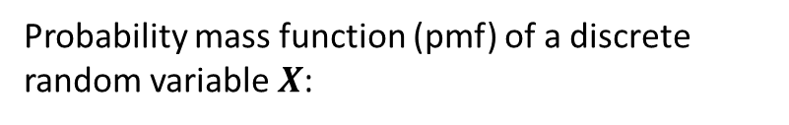
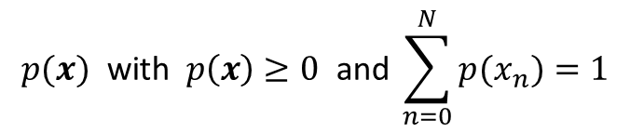
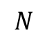
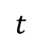
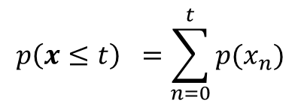
Probability mass function (pmf) of a discrete random variable $X$:
$$p(x) \text{with} p\left(x\right)≥0 \text{and} \sum_{n=0}^{N}{p(x_{n})}=1$$
Binomial pmf
Possible values of $X$
Area (sum)
0
$$t$$
$$N$$
$$p\left(x≤t\right) =\sum_{n=0}^{t}{p(x_{n})}$$
Bayesian Data Analysis – A Primer Workshop 2021 Marco D’Alessandro (PhD) ISTC CNR Italy

Slide 13

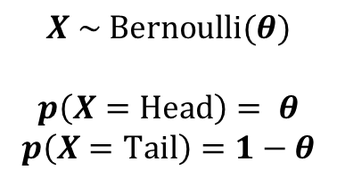
We need probability models for describing events in the world, or phenomena, which are noisy and complex
COIN FLIP
(the quintessence of probabilistic modeling)
Outcome:
Head
Tail
Model:
$$X \sim Bernoulli(θ)$$
$$p\left(X=Head\right)= θ$$
$$p\left(X=Tail\right)=1−θ$$
Bayesian Data Analysis – A Primer Workshop 2021 Marco D’Alessandro (PhD) ISTC CNR Italy

Slide 14
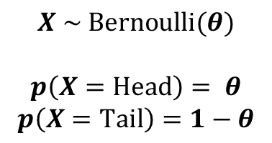
Probability INSIDE and OUTSIDE our MIND
COIN FLIP
(the quintessence of probabilistic modeling)
Outcome:
Head
Tail
Model:
$$X \sim Bernoulli(θ)$$
$$p\left(X=Head\right)= θ$$
$$p\left(X=Tail\right)=1−θ$$
Bayesian Data Analysis – A Primer Workshop 2021 Marco D’Alessandro (PhD) ISTC CNR Italy

Slide 15
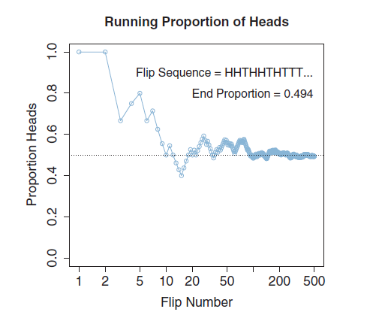
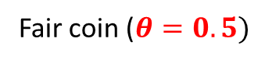
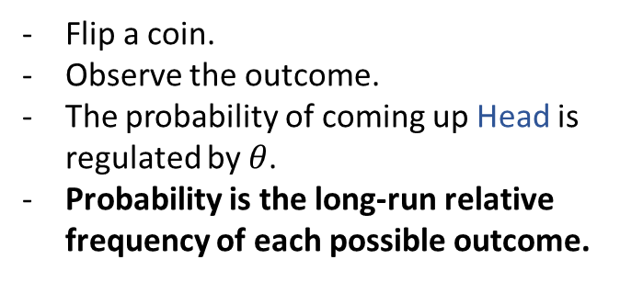
Probability OUTSIDE
Flip a coin.
Observe the outcome.
The probability of coming up Head is regulated by $θ$.
Probability is the long-run relative frequency of each possible outcome.
COIN FLIP
(the quintessence of probabilistic modeling)
Outcome:
Head
Tail
Fair coin ($θ=0.5)$
Model:
$$X \sim Bernoulli(θ)$$
$$p\left(X=Head\right)= θ$$
$$p\left(X=Tail\right)=1−θ$$
Bayesian Data Analysis – A Primer Workshop 2021 Marco D’Alessandro (PhD) ISTC CNR Italy

Slide 16
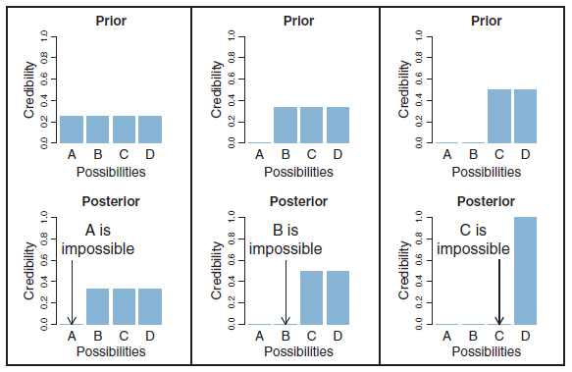
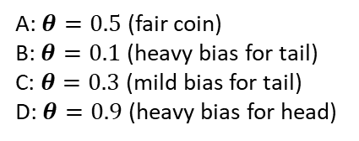
Probability INSIDE (subject belief)
How likely we think each possible outcome is.
COIN FLIP
We use probability to assign values to possibilities.
(the quintessence of probabilistic modeling)
Belief
Outcome:
Head
Tail
e.g. Hypotheses, Parameters
Model:
$$X \sim Bernoulli(θ)$$
$$p\left(X=Head\right)= θ$$
$$p\left(X=Tail\right)=1−θ$$
A: $θ=0.5$ (fair coin)
B: $θ=0.1$ (heavy bias for tail)
C: $θ=0.3$ (mild bias for tail)
D: $θ=0.9$ (heavy bias for head)
Bayesian Data Analysis – A Primer Workshop 2021 Marco D’Alessandro (PhD) ISTC CNR Italy

Slide 17
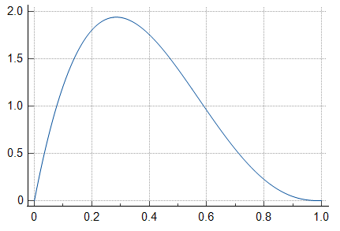

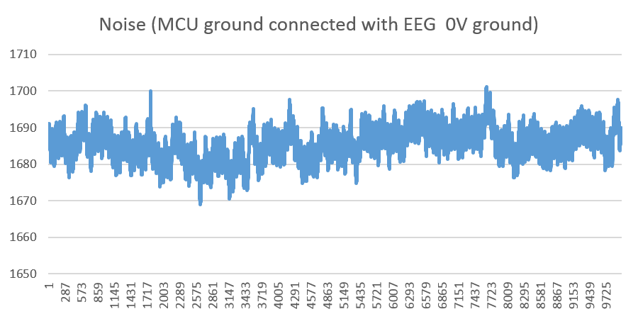
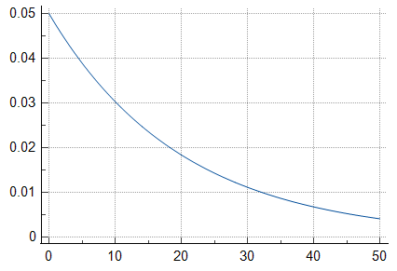
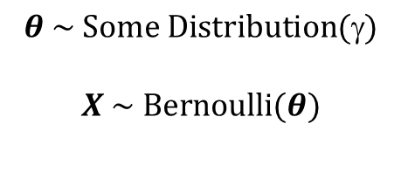
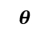
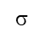
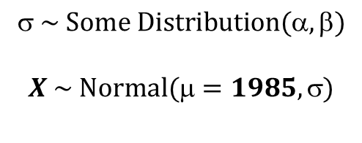
Probability beliefs over probabilities
$$θ \sim Some Distribution(γ)$$
$$X \sim Bernoulli(θ)$$
$$θ$$
Uncertainty belief about uncertainty
$$ \sim Some Distribution(α,β)$$
$$X \sim Normal(μ=1985, σ)$$
$$$$
Bayesian Data Analysis – A Primer Workshop 2021 Marco D’Alessandro (PhD) ISTC CNR Italy

Slide 18
Uncertainty in Bayesian Probabilistic Modeling
Probability beliefs over probabilities
Uncertainty belief about uncertainty
Aleatoric uncertainty – irreducible, intrinsic uncertainty (e.g., the variance term in a regression model, coin flips…)
Epistemic uncertainty – reducible, extrinsic uncertainty (e.g., posterior over the variance term in a regression model)
- Approximation uncertainty
- Model (misspecification) uncertainty
- Estimation uncertainty
Bayesian Data Analysis – A Primer Workshop 2021 Marco D’Alessandro (PhD) ISTC CNR Italy

Slide 19
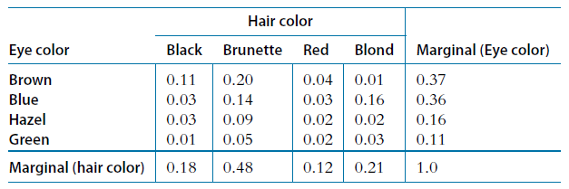
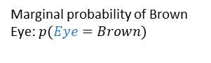
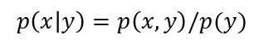
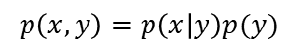

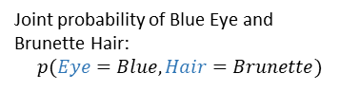
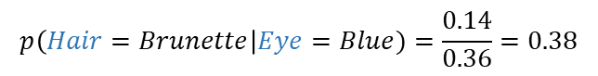
Bayesian Inference
But first, a core concept: conditional probability
Two-way discrete table: 2 random variables, Eye color, Hair color.
Joint probability of Blue Eye and Brunette Hair:
$$p(Eye=Blue, Hair=Brunette)$$
Marginal probability of Brown Eye: $p(Eye=Brown)$
Marginal probability of Blond Hair: $p(Eye=Brown)$
$$p\left(x,y\right)=p\left(x | y\right)p(y)$$
$$p\left(Hair=Brunette\right|Eye=Blue)=p(Hair=Brunette,Eye=Blue)/p(Eye=Blue)$$
$$p\left(x | y\right)=p\left(x,y\right)/p(y)$$
$$p\left(Hair=Brunette\right|Eye=Blue)=\frac{0.14}{0.36}=0.38$$
Bayesian Data Analysis – A Primer Workshop 2021 Marco D’Alessandro (PhD) ISTC CNR Italy

Slide 20

Bayesian Inference
What should all of this have to do with Bayesian Data Analysis?
Let’s apply the two-way table logic to DATA and PARAMETERS
All the Parameters related to our model
All the possible Datasets
Marginal probability of the Data
The joint probability of Data and Parameters
Bayesian Data Analysis – A Primer Workshop 2021 Marco D’Alessandro (PhD) ISTC CNR Italy

Slide 21

Bayesian Inference
Likelihood
$$p\left(θ | D\right)=\frac{p\left(θ,D\right)}{p(D)}=\frac{p\left(D|θ\right)p(θ)}{p(D)}$$
Prior
Posterior
Evidence (Marginal Likelihood)
Bayesian Data Analysis – A Primer Workshop 2021 Marco D’Alessandro (PhD) ISTC CNR Italy

Slide 22


Bayesian Inference
$$p\left(θ | D\right) \text{∝} p\left(D|θ\right)p(θ)$$
From prior belief $p(θ)$ to posterior belief $p\left(θ | D\right)$
Model inversion (reverse engineering) from $p\left(D|θ\right)$ to $p\left(θ | D\right)$.
In Bayesian Statistics, EVERYTHING has a probability distribution, both Data and Parameters
Bayesian Data Analysis – A Primer Workshop 2021 Marco D’Alessandro (PhD) ISTC CNR Italy

Slide 23





















Bayesian Inference
(A simple discrete case)
$$0.416$$
$$0.250$$
$$0.250$$
$$0.235$$
$0.1$66
$$0.166$$
$$0.166$$
$$0.152$$
$$0.178$$
$$0.017$$
$$p\left(θ=0.3 | D=\{y=1, N=3\}\right)=\frac{p\left(D|θ=0.3\right)p(θ=0.3)}{Z}$$
$$0.441$$
$$0.375$$
$$0.243$$
$$=\frac{0.441 ×0.250}{Z}=0.416$$
$$0.189$$
$$0.027$$
Normalization Constant
$$Z=p\left(D\right)=\sum_{i}{p\left(D | θ_{i}\right)p\left(θ_{i}\right)=}$$
$$0.166\left(0.243\right)+0.250\left(0.441\right)+…+0.166(0.027)=0.265$$
Bayesian Data Analysis – A Primer Workshop 2021 Marco D’Alessandro (PhD) ISTC CNR Italy

Slide 24



Bayesian Inference
(A simple discrete case)
How $p\left(D|θ=0.3\right)$ is computed
Choose a probabiliy model describing the data (e.g. Binomial)
$$y \sim Binomial(N,θ)$$
$$p\left(D=\{y=1, N=3\}|θ=0.3\right) \text{∝} θ^{y}{(1−θ)}^{N−y} ={0.3}^{1}{(0.7)}^{2}$$
My data are $D=\{y=1, N=3\}$
$D$ is fixed. I plug-in each value of $θ$ and compute the likelihood for each of them.
Bayesian Data Analysis – A Primer Workshop 2021 Marco D’Alessandro (PhD) ISTC CNR Italy

Slide 25

Bayesian Inference
(A more realistic scenario)
I flip a coin 30 times and obtain head 5 times. Make inference about the rate parameter regulating head outcomes
$$D=\{y=5, N=30\}$$
Bayesian Data Analysis – A Primer Workshop 2021 Marco D’Alessandro (PhD) ISTC CNR Italy

Slide 26




Bayesian Inference
(A more realistic scenario)
Probability model for the Prior
$$θ\sim Beta(α,β)$$
$$θ$$
I consider all the possible continous values of $θ$.
Bayesian Data Analysis – A Primer Workshop 2021 Marco D’Alessandro (PhD) ISTC CNR Italy

Slide 27




Bayesian Inference
(A more realistic scenario)
Probability model for the data (Likelihood)
$$y \sim Binomial(N,θ)$$
$$y$$
Note: the figure shows the probability of observing each possible value of $y$, with fixed N and $θ$.
Bayesian Data Analysis – A Primer Workshop 2021 Marco D’Alessandro (PhD) ISTC CNR Italy

Slide 28


Bayesian Inference
(A more realistic scenario)
Specify the prior
$$θ\sim Beta(4,4)$$
Bayesian Data Analysis – A Primer Workshop 2021 Marco D’Alessandro (PhD) ISTC CNR Italy

Slide 29

Bayesian Inference
(A more realistic scenario)
Compute the likelihood
Bayesian Data Analysis – A Primer Workshop 2021 Marco D’Alessandro (PhD) ISTC CNR Italy

Slide 30

Bayesian Inference
(A more realistic scenario)
Compute the posterior
Bayesian Data Analysis – A Primer Workshop 2021 Marco D’Alessandro (PhD) ISTC CNR Italy

Slide 31
Bayesian Inference
(A more realistic scenario)
Compute the posterior
Bayesian Data Analysis – A Primer Workshop 2021 Marco D’Alessandro (PhD) ISTC CNR Italy

Slide 32

Bayesian Inference
(A more realistic scenario)
Posterior
Compute the posterior
Prior
Likehood
Bayesian Data Analysis – A Primer Workshop 2021 Marco D’Alessandro (PhD) ISTC CNR Italy

Slide 33



Bayesian Inference
(A more realistic scenario)
The Beta-Binomial case has an analytical solution
$$θ\sim Beta(α,β)$$
$$y \sim Binomial(N,θ)$$
$p\left(θ | D=\left\{y,N\right\}\right) \text{∝} Binomial(y|N,θ)$ $Beta(θ|,)$
$p\left(θ | D\right)=$ $Beta(+y,+N−y)$
The two new parameters defining the posterior, which is a Beta distribution
The Beta distribution is a CONJUGATE PRIOR for the Binomial likelihood function
Bayesian Data Analysis – A Primer Workshop 2021 Marco D’Alessandro (PhD) ISTC CNR Italy

Slide 34
Some important characteristics of Bayesian Modeling
(things to have in mind)
Ability to incorporate prior information
Shrinkage
Impact of data properties (e.g. sample size) on the posterior
Natural propagation of uncertainty
Data-order invariance
Sequential updating
Bayesian Data Analysis – A Primer Workshop 2021 Marco D’Alessandro (PhD) ISTC CNR Italy

Slide 35



Ability to incorporate prior information
Uninformative
Informative
Current knowledge in the literature
Bayesian Data Analysis – A Primer Workshop 2021 Marco D’Alessandro (PhD) ISTC CNR Italy

Slide 36



Shrinkage
Likelihood
Prior
Posterior
Bayesian Data Analysis – A Primer Workshop 2021 Marco D’Alessandro (PhD) ISTC CNR Italy

Slide 37






Impact of data properties (e.g. sample size) on the posterior
$$D=\left\{y=1,N=4\right\}$$
No need for post-processing results to compute weird quantities such as Confidence Intervals or p-values. In Bayesian Modeling we have everything for free!
$$D=\left\{y=5,N=20\right\}$$
$$D=\left\{y=10,N=40\right\}$$
Bayesian Data Analysis – A Primer Workshop 2021 Marco D’Alessandro (PhD) ISTC CNR Italy

Slide 38







Natural propagation of uncertainty
$$D=\{y=\left[−4.5, −0.2, 1.2, −3.5, …, −5.5, −6.5\right]\}$$
$$y \sim Normal(μ,σ=3)$$
$$\sim Normal(0,10)$$
Transformation of the random variable $$
Transformed $$
Posterior over $\frac{1}{exp⁡(μ)}$
Bayesian Data Analysis – A Primer Workshop 2021 Marco D’Alessandro (PhD) ISTC CNR Italy

Slide 39

Natural propagation of uncertainty
A medical example: Two fictitious vaccinations against a know virus, frequentistus, are tested on a group of participants. Vaccination A is an active treatment, vaccination B is a control placebo treatment. Of the 40 participants, 30 are randomly assigned to have treatment A and the other 10 are given the control treatment. Six months after the vaccination, one participant in group A has been tested positive, in group B, three have been tested positive. Thus, the data is:
Is treatment A better than treatment B?
What is the probability that treatment A is better than B?
Bayesian Data Analysis – A Primer Workshop 2021 Marco D’Alessandro (PhD) ISTC CNR Italy

Slide 40







Natural propagation of uncertainty
$$D_{1}$$
$$D_{2}$$
Data
$$D_{1}=\{y_{1}=1,N_{1}=30\}$$
$$D_{2}=\{y_{2}=3,N_{2}=10\}$$
Prior
$$θ_{1}\sim Beta(1,1)$$
$$θ_{2}\sim Beta(1,1)$$
Goal
$$θ_{diff}=θ_{1}−θ_{2}$$
Bayesian Data Analysis – A Primer Workshop 2021 Marco D’Alessandro (PhD) ISTC CNR Italy

Slide 41







Natural propagation of uncertainty
$$θ_{1}$$
$θ_{diff}$($θ_{1}−θ_{2}$)
probability that $θ_{1}$is lower than $θ_{2}$, that is, that treatment A is better than B
$$θ_{2}$$
Bayesian Data Analysis – A Primer Workshop 2021 Marco D’Alessandro (PhD) ISTC CNR Italy

Slide 42







Data-order invariance and Sequential Updating
The posterior is the new prior
I can change the order, it doesn’t matter
Prevent from p-hacking, another weird flaw of the frequentist approach!
$$D_{t=1}=\{y=1,N=3\}$$
$$D_{t=2}=\{y=5,N=6\}$$
$$D_{t=2}=\{y=3,N=7\}$$
Bayesian Data Analysis – A Primer Workshop 2021 Marco D’Alessandro (PhD) ISTC CNR Italy

Slide 43

Bayesian Inference
(summary)
Bayesian modeling allows us to express the concepts of learning, belief updating, and uncertainty in terms of basic probability theory.
It’s just probability theory!
Given a hypothesis space ℋ and a prior $p(h)$, the goal of Bayesian inference is to replace the prior with the posterior, $p\left(h | \text{𝒟}\right)$, based on observed data $\text{𝒟}$:
$$p\left(h | \text{𝒟}\right)=\frac{p\left(\text{𝒟} | h\right)p\left(h\right)}{p(\text{𝒟})}∝p\left(\text{𝒟} | h\right)p\left(h\right)$$
where $p\left(\text{𝒟} | h\right)$ is the likelihood of $h$ and $p(\text{𝒟})$ is called the evidence or marginal likelihood.
Bayesian Data Analysis – A Primer Workshop 2021 Marco D’Alessandro (PhD) ISTC CNR Italy

Slide 44








A sad Frequentist Story
We collected a sample of scores of N individuals and want to test the hypothesis that the mean score differs from 0.
$H_{0}: $=0
Null Model
What are we actually computing ?
$p(H_{0}|D)$ is not $p\left(D | H_{0}\right)‼‼‼‼$
When we test $H_{0}$, we find the probability that the data $D$ could have arisen if $H_{0}$was true
P-value < 0.05 (reject $H_{0}$)
$$t$$
$$p(D|H_{0})$$
Reality: When we reject $H_{0}$ we want to conclude that $H_{0}$ is unlikely
$$p(H_{0}|D)$$
Cohen, 1994
Bayesian Data Analysis – A Primer Workshop 2021 Marco D’Alessandro (PhD) ISTC CNR Italy

Slide 45
Bayesian Computation
Make things a little bit funnier!
Bayesian Data Analysis – A Primer Workshop 2021 Marco D’Alessandro (PhD) ISTC CNR Italy

Slide 46










Bayesian Computation
What if I don’t have a conjugate prior model?
The 99% of the cases
Model
Priors
$$y_{s}=_{0,s}+_{1,s}x+$$
$ \sim Exp(0.1)$
$$ \sim Normal(0,σ)$$
$$_{0}\sim Normal(0,100)$$
$$_{0,s} \sim Normal(γ_{0},ϑ)$$
$$_{1}\sim Normal(0,100)$$
$$_{1,s} \sim Normal(γ_{1},ω)$$
$$ϑ \sim InverseGamma(1,1)$$
$$ω \sim InverseGamma(1,1)$$
Bayesian Data Analysis – A Primer Workshop 2021 Marco D’Alessandro (PhD) ISTC CNR Italy

Slide 47
Bayesian Computation
Use MONTE CARLO methods to approximate the (joint) posterior
Repeated random sampling to obtain certain numerical results
Bayesian Data Analysis – A Primer Workshop 2021 Marco D’Alessandro (PhD) ISTC CNR Italy

Slide 48





Bayesian Computation
Use MONTE CARLO methods to approximate the (joint) posterior
A classic: the METROPOLIS-HASTING Algorithm
Suppose I want to obtain this distribution, but all I have is the probability density of different value of $θ$
Compute ${p(θ}^{′}\left|D\right)=p(D\left|θ^{′}\right)p(θ^{′})$
Compute ${p(θ}^{∗}\left|D\right)=p(D\left|θ^{∗}\right)p(θ^{∗})$
Start from a seed, say $θ^{∗}=0.27$
Sample a new $θ^{′}=0.32$
Bayesian Data Analysis – A Primer Workshop 2021 Marco D’Alessandro (PhD) ISTC CNR Italy

Slide 49




Bayesian Computation
Compare: $c=\frac{p(D\left|θ^{′}\right)p(θ^{′})}{p(D\left|θ^{∗}\right)p(θ^{∗})}$
Store it into a vector $θ^{post}=[…]$
Accept $θ^{′}$ with probability $c$,
otherwise retain $θ^{∗}$
Compute ${p(θ}^{′}\left|D\right)=p(D\left|θ^{′}\right)p(θ^{′})$
Compute ${p(θ}^{∗}\left|D\right)=p(D\left|θ^{∗}\right)p(θ^{∗})$
Start from a seed, say $θ^{∗}=0.27$
Sample a new $θ^{′}=0.32$
Bayesian Data Analysis – A Primer Workshop 2021 Marco D’Alessandro (PhD) ISTC CNR Italy

Slide 50

Bayesian Computation
A random Walk
Bayesian Data Analysis – A Primer Workshop 2021 Marco D’Alessandro (PhD) ISTC CNR Italy

Slide 51
Bayesian Computation
There are numerous flavors of MCMC algorithms:
Metropolis-Hastings (MH-MCMC, Metropolis et al., 1953; Hastings, 1970)
Hamiltonian (Hybrid) Monte Carlo (HMC, Duane et al., 1987)
Likelihood-free MCMC (ABC-MCMC, Marjoram et al., 2003)
Differential evolution (DE-MCMC, Turner et al., 2013)
No-U-Turn MCMC (NUTS, Hoffman & Gelman, 2011)
Transport map accelerated MCMC (Parno & Marzouk, 2017)
And many others
The logic is always the same!
Bayesian Data Analysis – A Primer Workshop 2021 Marco D’Alessandro (PhD) ISTC CNR Italy

Slide 52

Bayesian Computation
Markov Chain Monte Carlo
Sample from the chain to collect a pre-defined number L of samples $\{θ_{1},θ_{2},…θ_{L}\}$ from the posterior.
Approximate the posterior with an empirical estimate constructed from the collected samples.
Ideally, the collected samples approximate well the true posterior
Bayesian Data Analysis – A Primer Workshop 2021 Marco D’Alessandro (PhD) ISTC CNR Italy

Slide 53
Bayesian Computation
Markov Chain Monte Carlo
Ingredients:
Starting values (selected from the parameter space)
Number of iterations (the number of sample collected)
Number of chains (each time a chain starts from a seed and start sampling)
Burn-in, or Warm-up (number of samples to drop at the beginning of the sampling procedure
The parameters of the proposal distribution
Typically we want to set these four
Bayesian Data Analysis – A Primer Workshop 2021 Marco D’Alessandro (PhD) ISTC CNR Italy

Slide 54





Bayesian Computation
Markov Chain Monte Carlo
Chain 1
$$θ^{post}=[θ_{1}^{∗},θ_{2}^{∗},θ_{3}^{∗},…,θ_{1001}^{∗},…,θ_{L}^{∗}]$$
Chain 2
$$θ^{post}=[θ_{1}^{∗∗},θ_{2}^{∗∗},θ_{3}^{∗∗},…,θ_{1001}^{∗∗},…,θ_{L}^{∗∗}]$$
Bayesian Data Analysis – A Primer Workshop 2021 Marco D’Alessandro (PhD) ISTC CNR Italy

Slide 55



Bayesian Computation
Markov Chain Monte Carlo
IN PRACTICE
SAMPLER
WinBUGS
STAN
JAGS
Bayesian Data Analysis – A Primer Workshop 2021 Marco D’Alessandro (PhD) ISTC CNR Italy

Slide 56
Bayesian Computation
Markov Chain Monte Carlo
IN PRACTICE
STAN pipeline
Model specification
Compiling
Sampling
Save posterior samples
Do things with posterior samples
Bayesian Data Analysis – A Primer Workshop 2021 Marco D’Alessandro (PhD) ISTC CNR Italy

Slide 57
Bayesian Computation
Markov Chain Monte Carlo
IN PRACTICE
functions { // user-defined functions }
data { // data passed to the program }
parameters { // latent variables to be sampled }
transformed parameters { // variables obtained as functions of the parameters/data }
model { // specification of the likelihood + priors }
generated quantities { // quantities to be computed after sampling (e.g., posterior predictions) }
Bayesian Data Analysis – A Primer Workshop 2021 Marco D’Alessandro (PhD) ISTC CNR Italy

Slide 58



Bayesian Computation
Markov Chain Monte Carlo
IN PRACTICE
STAN Model
data {
int<lower=1> N;
vector[N] x;
vector[N] y;
}
parameters {
real beta0;
real beta1;
real<lower=0> sigma2;
}
transformed parameters {
real<lower=0> sigma;
sigma = sqrt(sigma2);
}
model {
sigma2 ~ inv_gamma(1, 1);
beta0 ~ normal(0, 100);
beta1 ~ normal(0, 100);
for(n in 1:N) y[n] ~ normal(beta0 + beta1*x[n], sigma);
}
Data
Bayesian Data Analysis – A Primer Workshop 2021 Marco D’Alessandro (PhD) ISTC CNR Italy

Slide 59
Ok, now we have the posterior distributions for each parameter
Then What?
Use posteriors in any way you want:
Transform posteriors
Compute statistics on the posteriors
Do hypothesis testing
Simulate Data
Bayesian Data Analysis – A Primer Workshop 2021 Marco D’Alessandro (PhD) ISTC CNR Italy

Slide 60


Bayesian Inference
(Point Null) Hypothesis Testing
Regression problem
$$y= _{0}+_{1}x+ $$
Bayesian Data Analysis – A Primer Workshop 2021 Marco D’Alessandro (PhD) ISTC CNR Italy

Slide 61




Bayesian Inference
(Point Null) Hypothesis Testing
$$y= _{0}+_{1}x+ $$
Make inference on $_{1}$
Prior on $_{1}$
$$_{1} \sim Normal(0, 10)$$
Bayesian Data Analysis – A Primer Workshop 2021 Marco D’Alessandro (PhD) ISTC CNR Italy

Slide 62



Bayesian Inference
(Point Null) Hypothesis Testing
Posterior Density
We can discern the credible values of the parameter. If the null value is far from the credible values, we reject the null value as not credible.
$$_{1}$$
$H_{0}:_{1}$=0
Bayesian Data Analysis – A Primer Workshop 2021 Marco D’Alessandro (PhD) ISTC CNR Italy

Slide 63

Bayesian Inference
(Point Null) Hypothesis Testing
Highest Density Intervals (HDIs)
All points within the interval have a higher probability density than points outside the interval
Bayesian Data Analysis – A Primer Workshop 2021 Marco D’Alessandro (PhD) ISTC CNR Italy

Slide 64

Bayesian Inference
(Point Null) Hypothesis Testing
Equal-Tailed Interval (ETI)
2.5% of the distribution on either side of its limits
Equal area
Bayesian Data Analysis – A Primer Workshop 2021 Marco D’Alessandro (PhD) ISTC CNR Italy

Slide 65
Bayesian Inference
(Point Null) Hypothesis Testing
Equal-Tailed Interval (ETI)
Less sensitive to transformation applied to the distribution (e.g. log-odds to probabilities)
Highest Density Intervals (HDIs)
Very sensitive to transformation applied to the distribution. If you want credible intervals of an exponentiated distribution, ETI is better
Bayesian Data Analysis – A Primer Workshop 2021 Marco D’Alessandro (PhD) ISTC CNR Italy

Slide 66

Bayesian Inference
(Point Null) Hypothesis Testing
Posterior Density
$$_{1}$$
$${CI}_{0.95}=[−0.72, 2.51]$$
Bayesian Data Analysis – A Primer Workshop 2021 Marco D’Alessandro (PhD) ISTC CNR Italy

Slide 67

Bayesian Inference
(Point Null) Hypothesis Testing
Posterior Density
$$_{1}$$
$$p(_{1}>0)$$
Bayesian Data Analysis – A Primer Workshop 2021 Marco D’Alessandro (PhD) ISTC CNR Italy

Slide 68





Bayesian Inference
(Point Null) Hypothesis Testing
Posterior Density
$$_{1}$$
Density Ratio
$H_{0}:_{1}=0$ (exactly equal to 0)
$H_{0}$ is nested within $H_{1}$
$H_{1}:_{1}$ can be everywhere
Bayesian Data Analysis – A Primer Workshop 2021 Marco D’Alessandro (PhD) ISTC CNR Italy

Slide 69


Bayesian Inference
(Point Null) Hypothesis Testing
Posterior Density
$$_{1}$$
Bayes Factor of $H_{0}$ versus $H_{1}$
After observing the Data
$$\frac{p(β_{1}|D)}{p(β_{1})}={BF}_{01}$$
Density Ratio
Before observing the Data
Bayesian Data Analysis – A Primer Workshop 2021 Marco D’Alessandro (PhD) ISTC CNR Italy

Slide 70












Bayesian Inference
(Point Null) Hypothesis Testing
$$\frac{p(β_{1}|D)}{p(β_{1})}={BF}_{01}$$
Bayes Factor of $H_{0}$ versus $H_{1}$
$H_{0}$
$H_{0}$
$${BF}_{01}=4.4$$
$H_{0}$
$H_{0}$
$H_{0}$
$H_{1}$
$H_{1}$
$H_{1}$
$H_{1}$
$H_{1}$
Bayesian Data Analysis – A Primer Workshop 2021 Marco D’Alessandro (PhD) ISTC CNR Italy

Slide 71

Diagnostics
What should we check before using posteriors
Chains convergence (R-hat, $\hat{R}$)
Chains autocorrelation (acf)
Chains Effective Sample Size (ESS)
Bayesian Data Analysis – A Primer Workshop 2021 Marco D’Alessandro (PhD) ISTC CNR Italy

Slide 72




Diagnostics
What should we check before using posteriors
Chains convergence (R-hat, $\hat{R}$)
Non-convergence ($\hat{R}>1$)
Convergence ($\hat{R}≈1$)
Bayesian Data Analysis – A Primer Workshop 2021 Marco D’Alessandro (PhD) ISTC CNR Italy

Slide 73


Diagnostics
What should we check before using posteriors
Chains autocorrelation (acf)
Bayesian Data Analysis – A Primer Workshop 2021 Marco D’Alessandro (PhD) ISTC CNR Italy

Slide 74
Diagnostics
What should we check before using posteriors
Effective Sample Size
Measures the amount by which autocorrelation in posterior samples increases uncertainty
It is an indicator of how accurate and stable the picture of the posterior distribution is
Low ESS (< 1000) means posterior is not reliable (you can’t compute HDI, ETI, or do Hypothesis testing)
Bayesian Data Analysis – A Primer Workshop 2021 Marco D’Alessandro (PhD) ISTC CNR Italy

Slide 75
Goodness of fit
Model Adequacy
In order for our model and inferences to be useful, we need to verify whether the model captures the relevant structure of the true data generating process.
Empirically, this can be verified only after the model has been applied to real observations/data.
Two main points to consider:
Generative performance (can the model reproduce the data)
Predictive performance (can the model predict new data, not relative to other models!)
Collectively called Posterior Predictive Checks (PPC)
Bayesian Data Analysis – A Primer Workshop 2021 Marco D’Alessandro (PhD) ISTC CNR Italy

Slide 76

Posterior Predictive Check
DATA
We sample data from an unknown generative process
Does our model capture the DATA generating process?
Compare observations with data reconstructed by the fitted model
Bayesian Data Analysis – A Primer Workshop 2021 Marco D’Alessandro (PhD) ISTC CNR Italy

Slide 77




Posterior Predictive Check
Steps:
Sample a parameter set $θ^{∗}=\left\{β_{0},β_{1}\right\}$ from the joint posterior $p\left(θ | D\right).$
Simulate a dataset according to $y \sim f(θ^{∗})$.
Stack the simulated dataset in $Y$.
Repeat $L$ times.
Goal:
Plot some distribution of statistics of $Y$ against observed data.
Bayesian Data Analysis – A Primer Workshop 2021 Marco D’Alessandro (PhD) ISTC CNR Italy

Slide 78

Bayesian Model Comparison
Models as mathematical embodiments of scientific hypotheses.
Formalizing scientific inquiries:
Bayesian parameter estimation: test theories about phenomena by inferring the parameters of the model and predicting the data
Bayesian model comparison: compare competing theories making different predictions
Models can be viewed as generative descriptions specified via the likelihood function:
$$y \sim p\left(y | θ\right)$$
Bayesian Data Analysis – A Primer Workshop 2021 Marco D’Alessandro (PhD) ISTC CNR Italy

Slide 79
Bayesian Model Comparison
From a Bayesian perspective, we want models to manage a trade-off between complexity and predictive performance.
Ideally: will collect two independent datasets from a domain. Use first for model development, fitting, and optimization and second for final evaluation of predictive performance.
Usually: will use the available dataset to approximate predictive performance.
Bayesian Data Analysis – A Primer Workshop 2021 Marco D’Alessandro (PhD) ISTC CNR Italy

Slide 80









Bayesian Model Comparison
Bayes Factor
A relative measure of model comparison
Two Models, that is, two competing theories
Model A
$$y=_{0}+$$
$$ \sim Normal(0,σ)$$
$$_{0} \sim Normal(0, 100)$$
$$ \sim Exponential(0.3)$$
Model B
$$y=_{0}+_{1}x+$$
$$ \sim Normal(0,σ)$$
$$_{0} \sim Normal(0, 100)$$
$$_{1} \sim Normal(0, 100)$$
$$ \sim Exponential(0.3)$$
Bayesian Data Analysis – A Primer Workshop 2021 Marco D’Alessandro (PhD) ISTC CNR Italy

Slide 81




Bayesian Model Comparison
Bayes Factor
A relative measure of model comparison
Model A
$$y=_{0}+$$
$$p\left(θ | \text{𝒟}\text{,}{ H}_{A}\right)=\frac{p\left(\text{𝒟} | θ,{ H}_{A}\right)p\left(θ|{ H}_{A}\right)}{p(\text{𝒟}|{ H}_{A})}$$
$$ \sim Normal(0,σ)$$
$$_{0} \sim Normal(0, 100)$$
We are expliciting the dependency to a specific Model, or Hypothesis, or Theory
$$ \sim Exponential(0.3)$$
Model B
$$y=_{0}+_{1}x+$$
$$ \sim Normal(0,σ)$$
$$p\left(θ | \text{𝒟}\text{,}{ H}_{B}\right)=\frac{p\left(\text{𝒟} | θ,{ H}_{B}\right)p\left(θ|{ H}_{B}\right)}{p(\text{𝒟}|{ H}_{B})}$$
$$_{0} \sim Normal(0, 100)$$
$$_{1} \sim Normal(0, 100)$$
$$ \sim Exponential(0.3)$$
Bayesian Data Analysis – A Primer Workshop 2021 Marco D’Alessandro (PhD) ISTC CNR Italy

Slide 82


Bayesian Model Comparison
Bayes Factor
A relative measure of model comparison
$$p\left(θ | \text{𝒟}\text{,}{ H}_{A}\right)=\frac{p\left(\text{𝒟} | θ,{ H}_{A}\right)p\left(θ|{ H}_{A}\right)}{p(\text{𝒟}|{ H}_{A})}$$
We are interested in these quantities
Probability to observe our DATA under our Model, or Theory, assumptions
$$p\left(θ | \text{𝒟}\text{,}{ H}_{B}\right)=\frac{p\left(\text{𝒟} | θ,{ H}_{B}\right)p\left(θ|{ H}_{B}\right)}{p(\text{𝒟}|{ H}_{B})}$$
Bayesian Data Analysis – A Primer Workshop 2021 Marco D’Alessandro (PhD) ISTC CNR Italy

Slide 83

Bayesian Model Comparison
Bayes Factor
A relative measure of model comparison
Compare the evidence for one model compared to the alternative one
The marginal likelihood is impossible to compute analytically. Bridge Sampling is used to approximate it.
$${ BF}_{AB}=\frac{p(\text{𝒟}|{ H}_{A})}{p(\text{𝒟}|{ H}_{B})}$$
Bayesian Data Analysis – A Primer Workshop 2021 Marco D’Alessandro (PhD) ISTC CNR Italy

Slide 84

Bayesian Model Comparison
Bayes Factor
A relative measure of model comparison
$${ BF}_{AB}=\frac{p(\text{𝒟}|{ H}_{A})}{p(\text{𝒟}|{ H}_{B})}$$
Embody Occam’s razor by automatically penalizing the prior complexity of a model (different than predictive performance!)
Bayesian Data Analysis – A Primer Workshop 2021 Marco D’Alessandro (PhD) ISTC CNR Italy

Slide 85
Bayesian Model Comparison
Out-of-Sample Predictive Performance
Using only available data
How to estimate predictions for new data without new data?
CROSS-VALIDATION (from Machine Learning)
Bayesian Data Analysis – A Primer Workshop 2021 Marco D’Alessandro (PhD) ISTC CNR Italy

Slide 86




Bayesian Model Comparison
CROSS-VALIDATION
Full dataset
In practice: INFEASIBLE!!!
Too high computational cost for MCMC
Fit
Fold 1
Test
Model 1
Fold 2
Test
Model 2
Estimate predictive
performance
Fold 3
Test
Model 3
$$⋮$$
$$⋮$$
$$⋮$$
Fold K
Test
Model K
Bayesian Data Analysis – A Primer Workshop 2021 Marco D’Alessandro (PhD) ISTC CNR Italy

Slide 87







Bayesian Model Comparison
Leave-One-Out Cross-Validation (LOO)
Drop obsevation${ y}_{i}$
$${p(θ|y}_{−i})$$
Plug-in
$${p(y}_{i}|θ)$$
$${{p(y}_{i}|y}_{−i})=\int{{p(y}_{i}|θ){p(θ|y}_{−i})\text{d}θ}$$
DATA $(y)$
DATA $({ y}_{−i})$
Repeat – Sum the log of results for each iteration
Obtain ${ELPD}_{loo}$ (Expected Log Predictive Density)
https://www.youtube.com/watch?v=vLx6lUlZ0fc&ab_channel=AkiVehtariAkiVehtari
Vehtari et al, 2019
Bayesian Data Analysis – A Primer Workshop 2021 Marco D’Alessandro (PhD) ISTC CNR Italy

Slide 88

BASIC BAYESIAN MODELING
Codes:
infer_normal_parameters.R
infer_binomial_parameters.R
infer_regression_parameters.R
Bayesian Data Analysis – A Primer Workshop 2021 Marco D’Alessandro (PhD) ISTC CNR Italy

Slide 89



Regression Modeling
Bayesian Data Analysis – A Primer Workshop 2021 Marco D’Alessandro (PhD) ISTC CNR Italy

Slide 90




Hierarchical Regression Modeling
School
T. Exp.
Class 1
Class 2
Class 3
…
Class N
Subj 1
Subj 1
Subj 1
Subj 1
Subj 2
Subj 2
Subj 2
Subj 2
Subj 3
Subj 3
Subj 3
Subj 3
…
…
…
…
Subj K
Subj K
Subj K
Subj K
Bayesian Data Analysis – A Primer Workshop 2021 Marco D’Alessandro (PhD) ISTC CNR Italy

Slide 91


Hierarchical Regression Modeling
Control
Method 1
Method 2
S1
S2
…
Sk
S1
S2
…
Sk
S1
S2
…
Sk
w1
w1
w1
w1
w1
w1
w1
w1
w1
w2
w2
w2
w2
w2
w2
w2
w2
w2
w3
w3
w3
w3
w3
w3
w3
w3
w3
…
…
…
…
…
…
…
…
…
wZ
wZ
wZ
wZ
wZ
wZ
wZ
wZ
wZ
Bayesian Data Analysis – A Primer Workshop 2021 Marco D’Alessandro (PhD) ISTC CNR Italy

Slide 92




Hierarchical Regression Modeling
(A)
Intraclass Correlation (ICC)
(B)
Between Cluster Variance
$$ICC=\frac{τ^{2}}{τ^{2}+σ^{2}}$$
(C)
Within Cluster Variance
Bayesian Data Analysis – A Primer Workshop 2021 Marco D’Alessandro (PhD) ISTC CNR Italy

Slide 93





Hierarchical Regression Modeling
$$_{1}=constant$$
Fixed component
Random Component
$$_{0s}\sim N(μ_{β_{0}},σ_{β_{0}})$$
Random Intercept
Bayesian Data Analysis – A Primer Workshop 2021 Marco D’Alessandro (PhD) ISTC CNR Italy

Slide 94




Hierarchical Regression Modeling
$$_{1s}\sim N(μ_{β_{1}},σ_{β_{1}})$$
Fixed component
Random Component
$$_{0s}\sim N(μ_{β_{0}},σ_{β_{0}})$$
Random Intercept and Slope
Bayesian Data Analysis – A Primer Workshop 2021 Marco D’Alessandro (PhD) ISTC CNR Italy

Slide 95




Hierarchical Regression Modeling
Intercept
$$_{0s}=_{0}+_{1}K_{s}+ε_{_{0}}$$
Level-2 Pred.
Slope
When adding Covariates
$$_{1s}=_{0}+_{1}K_{s}+ε_{_{1}}$$
Level-2 Pred.
Bayesian Data Analysis – A Primer Workshop 2021 Marco D’Alessandro (PhD) ISTC CNR Italy

Slide 96






































Hierarchical Regression Modeling
From ANOVA to Hierarchical Models
Condition 1
Condition 2
…
Condition J
Subj 1
Subj 2
Subj N
Subj 1
Subj 2
Subj N
Subj 1
Subj 2
Subj N
$${y1}_{1,1}$$
$${y1}_{2,1}$$
$${y1}_{N,1}$$
$${y1}_{1,2}$$
$${y1}_{2,2}$$
$${y1}_{N,2}$$
$${y1}_{1,J}$$
$${y1}_{2,J}$$
$${y1}_{N,J}$$
$${y2}_{1,1}$$
$${y2}_{2,1}$$
$${y2}_{N,1}$$
$${y2}_{1,2}$$
$${y2}_{2,2}$$
$${y2}_{N,2}$$
$${y2}_{1,J}$$
$${y2}_{2,J}$$
$${y2}_{N,J}$$
$${y3}_{1,1}$$
$${y3}_{2,1}$$
$${y3}_{N,1}$$
$${y3}_{1,2}$$
$${y3}_{2,2}$$
$${y3}_{N,2}$$
$${y3}_{1,J}$$
$${y3}_{2,J}$$
$${y3}_{N,J}$$
$$…$$
$$…$$
$$…$$
$$…$$
$$…$$
$$…$$
$$…$$
$$…$$
$$…$$
$${yk}_{1,1}$$
$${yk}_{2,1}$$
$${yk}_{N,1}$$
$${yk}_{1,2}$$
$${yk}_{2,2}$$
$${yk}_{N,2}$$
$${yk}_{1,J}$$
$${yk}_{2,J}$$
$${yk}_{N,J}$$
$$H_{0}:{ }_{(Condition 1)}={ }_{(Condition 2)}=…={ }_{(Condition J)}$$
Bayesian Data Analysis – A Primer Workshop 2021 Marco D’Alessandro (PhD) ISTC CNR Italy

Slide 97




Hierarchical Regression Modeling
Condition 1
$$_{0(s=1)}$$
Subj 1
$$_{0(s=2)}$$
Subj 2
$$_{_{0}}$$
$$_{0(s=3)}$$
Subj 3
Observation
Bayesian Data Analysis – A Primer Workshop 2021 Marco D’Alessandro (PhD) ISTC CNR Italy

Slide 98











Hierarchical Regression Modeling
Condition 1
Condition 2
$$_{0(s=1)}$$
$$_{0(s=1)}$$
$$_{_{0}}^{(1)}$$
$$_{0(s=2)}$$
$$_{0(s=2)}$$
$$_{0(s=3)}$$
$$_{_{0}}^{(2)}$$
$$_{0(s=3)}$$
Observations
Observations
$_{_{0}}^{(1)}:$Fixed Effect (Condition 1)
$H_{0}:{ }_{_{0}}^{(1)}$= $_{_{0}}^{(2)}$
$_{_{0}}^{(2)}:$Fixed Effect (Condition 2)
Bayesian Data Analysis – A Primer Workshop 2021 Marco D’Alessandro (PhD) ISTC CNR Italy

Slide 99






Hierarchical Regression Modeling
Generalized Linear Models
Two ingredients:
Probability Distribution of the Dependent Variable
Link function
$$y_{i}=F(_{i},)$$
Probability Distribution
$$_{i}=_{0}+_{1}x_{i}$$
Probability Distribution
$$y_{i}=F(_{i},)$$
Linear Predictor
$$λ_{i}=_{0}+_{1}x_{i}$$
$$g\left(μ_{i}\right)=λ_{i}$$
Link function
Bayesian Data Analysis – A Primer Workshop 2021 Marco D’Alessandro (PhD) ISTC CNR Italy

Slide 100






Hierarchical Regression Modeling
Generalized Linear Models:
Inverse-Gaussian
$$>0$$
$$>0$$
Probability Distribution
$$y_{i} \sim IG(μ_{i},λ)$$
Density
Linear Predictor
$$λ_{i}=_{0}+_{1}x_{i}$$
$$g\left(μ_{i}\right)=λ_{i}$$
Link function
$g\left(μ\right)=\frac{1}{μ^{2}}$ , $g\left(μ\right)=log⁡(μ)$ , $g\left(μ\right)=μ$
Support
Bayesian Data Analysis – A Primer Workshop 2021 Marco D’Alessandro (PhD) ISTC CNR Italy

Slide 101









Hierarchical Regression Modeling
Condition 1
Condition 2
$$_{0(s=1)}$$
$$_{0(s=1)}$$
$$_{_{0}}^{(1)}$$
$$_{0(s=2)}$$
$$_{0(s=2)}$$
$$_{0(s=3)}$$
$$_{_{0}}^{(2)}$$
$$_{0(s=3)}$$
Observations
Observations
$_{_{0}}^{(1)}:$Fixed Effect (Condition 1)
$H_{0}:{ }_{_{0}}^{(1)}$= $_{_{0}}^{(2)}$
$_{_{0}}^{(2)}:$Fixed Effect (Condition 2)
Bayesian Data Analysis – A Primer Workshop 2021 Marco D’Alessandro (PhD) ISTC CNR Italy

Slide 102





Hierarchical Regression Modeling
Generalized Linear Models:
Logistic (Binomial)
N trials
# successes out of N trials
Probability Distribution
$$y_{i} \sim Binomial(μ_{i})$$
Linear Predictor
$$λ_{i}=_{0}+_{1}x_{i}$$
$$λ_{i}=g\left(μ_{i}\right)=log\frac{μ_{i}}{1−μ_{i}}$$
Link function
$$_{i}=\frac{1}{1+e^{−(β_{0}+β_{1}x_{i})}}$$
Inverse Link function
Bayesian Data Analysis – A Primer Workshop 2021 Marco D’Alessandro (PhD) ISTC CNR Italy

Slide 103




Hierarchical Regression Modeling
Level 1: $Y_{ij}= _{0,i}+N(0,^{2})$
Level 2: $_{0,i}= _{0}+_{1}{Cov}_{i}+N(0,^{2})$
Bayesian Data Analysis – A Primer Workshop 2021 Marco D’Alessandro (PhD) ISTC CNR Italy

Slide 104




Hierarchical Regression Modeling
Level 1: $Y_{ij}= _{0,i}+_{1}X_{ij}+N(0,^{2})$
Level 2: $_{0,i}= _{0}+_{1}{Cov}_{i}+N(0,^{2})$
Bayesian Data Analysis – A Primer Workshop 2021 Marco D’Alessandro (PhD) ISTC CNR Italy

Slide 105






Hierarchical Regression Modeling
Level 1: $Y_{ij}= _{0,i}+_{1,i}X_{ij}+N(0,^{2})$
Level 2: $_{0,i}= _{0}+_{1}{Cov}_{i}+N(0, {_{0}}^{2})$
$_{1,i}= _{2}+N(0,{_{1}}^{2})$
Bayesian Data Analysis – A Primer Workshop 2021 Marco D’Alessandro (PhD) ISTC CNR Italy

Slide 106





Hierarchical Regression Modeling
Level 1: $Y_{ij}= _{0,i}+_{1,i}X_{ij}+N(0,^{2})$
Level 2: $_{0,i}= _{0}+_{1}{Cov}_{i}+N(0, {_{0}}^{2})$
$_{1,i}= _{2}+_{3}{Cov}_{i}+N(0,{_{1}}^{2})$
Bayesian Data Analysis – A Primer Workshop 2021 Marco D’Alessandro (PhD) ISTC CNR Italy

Slide 107


Hierarchical Regression Modeling
The trick for LONGITUDINAL DATA
Bayesian Data Analysis – A Primer Workshop 2021 Marco D’Alessandro (PhD) ISTC CNR Italy

Slide 108



Hierarchical Regression Modeling
$$Y_{i}= _{0}+_{1}T_{i}+N(0,^{2})$$
$${Score}_{i}=5+2×T_{i}−0.1×{\left(T_{i}\right)}^{2} +N(0,σ^{2})$$
$$(Growth rate) {Score}_{i}=2−0.2×T_{i}$$
$${Score}_{i}=5 −0.4×T_{i}+0.5×{\left(T_{i}\right)}^{2} +N(0,σ^{2})$$
$$\left(Growth rate\right) {Score}_{i}=−0.4+T_{i}$$
The trick for LONGITUDINAL DATA – Individual level
Bayesian Data Analysis – A Primer Workshop 2021 Marco D’Alessandro (PhD) ISTC CNR Italy

Slide 109
Hierarchical Regression Modeling
When the Bayesian part comes into play
Bayesian Data Analysis – A Primer Workshop 2021 Marco D’Alessandro (PhD) ISTC CNR Italy

Slide 110





Hierarchical Regression Modeling
$$_{0s}\sim N(μ_{β_{0}},σ_{β_{0}})$$
Fixed Component
Random Component
$$_{_{0}}$$
$$_{_{0}}$$
Bayesian Data Analysis – A Primer Workshop 2021 Marco D’Alessandro (PhD) ISTC CNR Italy

Slide 111
Hierarchical Regression Modeling
A lot of probability distributions!
The distribution of the errors within each individual (or any cluster)
The distribution of the individual-level parameters
The prior distribution of the parameters of the distribution of the individual-level parameters
…
Bayesian Data Analysis – A Primer Workshop 2021 Marco D’Alessandro (PhD) ISTC CNR Italy

Slide 112









Hierarchical Regression Modeling
Let’s build the generative process (bottom-up)
$$y_{ij}= _{0,i}+_{1,i}x_{ij}+$$
$$ \sim Normal(0, σ^{2})$$
$$_{0,i} \sim Normal(μ_{β_{0}}, σ_{β_{0}})$$
$$_{1,i} \sim Normal(μ_{β_{1}},{ σ}_{β_{1}})$$
$$^{2} \sim Exponential(0.3)$$
$$_{β_{0}} \sim Normal(0, 100)$$
$$_{β_{1}} \sim Normal(0, 100)$$
$$_{β_{0}}\sim InverseGamma(1,1)$$
$$_{β_{1}}\sim InverseGamma(1,1)$$
Bayesian Data Analysis – A Primer Workshop 2021 Marco D’Alessandro (PhD) ISTC CNR Italy

Slide 113









Hierarchical Regression Modeling
Let’s build the generative process (Top-down)
$$^{2} \sim Exponential(0.3)$$
$$_{β_{0}} \sim Normal(0, 100)$$
$$_{β_{0}}\sim InverseGamma(1,1)$$
Sample (latent) parameters from the priors
$$_{β_{1}} \sim Normal(0, 100)$$
$$_{β_{1}}\sim InverseGamma(1,1)$$
$$_{0,i} \sim Normal(μ_{β_{0}}, σ_{β_{0}})$$
Generate individual-level regression coefficients
$$_{1,i} \sim Normal(μ_{β_{1}},{ σ}_{β_{1}})$$
$$ \sim Normal(0, σ^{2})$$
Generate individual-level datasets
$$y_{ij}= _{0,i}+_{1,i}x_{ij}+$$
Bayesian Data Analysis – A Primer Workshop 2021 Marco D’Alessandro (PhD) ISTC CNR Italy

Slide 114









Hierarchical Regression Modeling
Let’s build the generative process (Top-down)
$$_{_{0}}$$
$$_{_{0}}$$
$$_{_{0}}$$
$$_{_{0}}$$
$$^{2} \sim Exponential(0.3)$$
$$_{β_{0}} \sim Normal(0, 100)$$
$$_{β_{0}}\sim InverseGamma(1,1)$$
$$_{0,i}$$
$$_{1,i}$$
$$_{β_{1}} \sim Normal(0, 100)$$
$$_{β_{1}}\sim InverseGamma(1,1)$$
$$^{2}$$
$$y_{ij}$$
$$_{0,i} \sim Normal(μ_{β_{0}}, σ_{β_{0}})$$
$$_{1,i} \sim Normal(μ_{β_{1}},{ σ}_{β_{1}})$$
$$x_{ij}$$
Obs j
$$ \sim Normal(0, σ^{2})$$
Subj i
$$y_{ij}= _{0,i}+_{1,i}x_{ij}+$$
Bayesian Data Analysis – A Primer Workshop 2021 Marco D’Alessandro (PhD) ISTC CNR Italy

Slide 115











Hierarchical Regression Modeling
$$^{2} \sim Exponential(0.3)$$
Why it is easy to fit Bayesian Hierarchical Models
$$_{β_{0}} \sim Normal(0, 100)$$
$$_{β_{0}}\sim InverseGamma(1,1)$$
Chain rule:
$$p\left(x, θ\right)=p\left(x \right| θ)p\left(θ\right)$$
$$p\left(x, θ, η\right)=p\left(x \right| θ, η)p\left(θ | η\right)p(η)$$
Are you scared! You don’t have to. We don’t care about all this
$$_{β_{1}} \sim Normal(0, 100)$$
(2 variables)
$$_{β_{1}}\sim InverseGamma(1,1)$$
(3 variables)
$$_{0,i} \sim Normal(μ_{β_{0}}, σ_{β_{0}})$$
$p\left(σ^{2},μ_{_{0}},σ_{_{0}},μ_{_{1}},σ_{_{1}}|y_{ij},x_{ij}\right)=\prod_{i}{p(y_{ij}|_{0,i},_{1,i},}$ $x_{ij},^{2})$ $\prod_{i}{p(_{0,i}|μ_{_{0}},}σ_{_{0}})…p\left(μ_{_{0}}\right)p\left(μ_{_{1}}\right)p\left(σ_{_{0}}\right)p\left(σ_{_{1}}\right)p(σ^{2})$
$$_{1,i} \sim Normal(μ_{β_{1}},{ σ}_{β_{1}})$$
$$ \sim Normal(0, σ^{2})$$
$$y_{ij}= _{0,i}+_{1,i}x_{ij}+$$
We use MCMC to sample parameters, evaluate the posterior density, and use the rejection procedure to retain or drop the parameters
Bayesian Data Analysis – A Primer Workshop 2021 Marco D’Alessandro (PhD) ISTC CNR Italy

Slide 116
Hierarchical Regression Modeling
Specifying a hierarchical model in STAN is not so easy. Error handling is hard, and the code can become huge.
SOLUTION: use BRMS, and R Package for Bayesian Hierarchical Modeling
Bayesian Data Analysis – A Primer Workshop 2021 Marco D’Alessandro (PhD) ISTC CNR Italy

Slide 117


Hierarchical Modeling with brms
brms can fit a wide variety of models of the form:
$$y_{i} \sim D\left(f\left(η_{i}\right), θ_{i}\right) \\ with \\ η=Xβ+Zu$$
using a syntax familiar from lme4:
Bayesian Data Analysis – A Primer Workshop 2021 Marco D’Alessandro (PhD) ISTC CNR Italy

Slide 118

Hierarchical Modeling with brms
Workflow of brms (Bürkner, 2017)
Bayesian Data Analysis – A Primer Workshop 2021 Marco D’Alessandro (PhD) ISTC CNR Italy

Slide 119



Hierarchical Modeling with brms
Bayesian Data Analysis – A Primer Workshop 2021 Marco D’Alessandro (PhD) ISTC CNR Italy

Slide 120
Hierarchical Modeling
Codes:
infer_hierarchical_normal_parameters.R
bayesian_hiearchical_3factorial.R
bayesian_hiearchical_longitudinal.R
bayesian_hiearchical_changepoint.R
Bayesian Data Analysis – A Primer Workshop 2021 Marco D’Alessandro (PhD) ISTC CNR Italy

Slide 121



Readings
Amateur Level
#1
#2
#3
Bayesian Data Analysis – A Primer Workshop 2021 Marco D’Alessandro (PhD) ISTC CNR Italy

Slide 122



Readings
Pro Level
#1
#2
#3
Bayesian Data Analysis – A Primer Workshop 2021 Marco D’Alessandro (PhD) ISTC CNR Italy

Slide 123



Readings
God Level
#1
#2
#3
Bayesian Data Analysis – A Primer Workshop 2021 Marco D’Alessandro (PhD) ISTC CNR Italy

Slide 124
List of PGMs per code
Bayesian Data Analysis – A Primer Workshop 2021 Marco D’Alessandro (PhD) ISTC CNR Italy

Slide 125





model_normal.stan
$$$$
$$$$
$$x_{n}$$
$$^{2}$$
Obs $n$
Bayesian Data Analysis – A Primer Workshop 2021 Marco D’Alessandro (PhD) ISTC CNR Italy

Slide 126







model_binomial.stan
$$θ_{diff}$$
$$θ_{1}$$
$$θ_{2}$$
$$y_{1}$$
$$y_{2}$$
$$N_{1}$$
$$N_{2}$$
Bayesian Data Analysis – A Primer Workshop 2021 Marco D’Alessandro (PhD) ISTC CNR Italy

Slide 127







model_simple_regression.stan
$$_{0}$$
$$_{1}$$
$$$$
$$y_{n}$$
$$^{2}$$
$$x_{n}$$
Obs $n$
Bayesian Data Analysis – A Primer Workshop 2021 Marco D’Alessandro (PhD) ISTC CNR Italy

Slide 128



model_simple_regression.stan
$$_{0}$$
$$_{1}$$
$$$$
$$_{2}$$
$$y_{n}$$
$$^{2}$$
$$x_{n}$$
$${xs}_{n}$$
Obs $n$
Bayesian Data Analysis – A Primer Workshop 2021 Marco D’Alessandro (PhD) ISTC CNR Italy

Slide 129











model_hierarchical_normal_nopooling.stan
$$_{1}$$
$$_{2}$$
$$_{I}$$
$$x_{1n}$$
$$x_{2n}$$
$$x_{In}$$
Obs$n_{1}$
Obs$n_{2}$
Obs$n_{I}$
$$^{2}$$
$$$$
Bayesian Data Analysis – A Primer Workshop 2021 Marco D’Alessandro (PhD) ISTC CNR Italy

Slide 130








model_hierarchical_normal_partialpooling.stan
$$$$
$$$$
$$_{i}$$
$$$$
$$x_{i,n}$$
$$^{2}$$
Obs $n$
Group $i$
Bayesian Data Analysis – A Primer Workshop 2021 Marco D’Alessandro (PhD) ISTC CNR Italy

